Slide 1
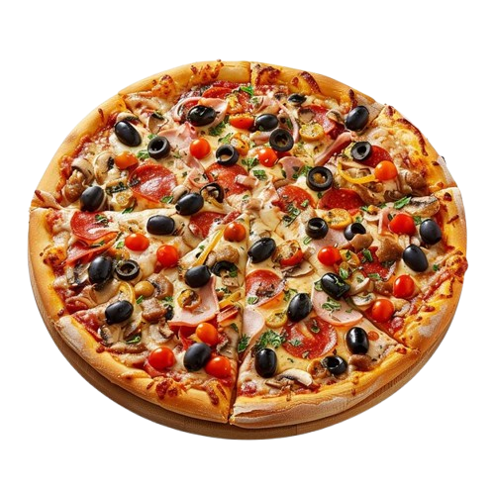
Pizza Sales Analysis
Analyzing, Trends , Performance And Opportunity
Presented By : Ibrahim Zainab Ilomeze
To Techie Academy
Date : July 12, 2025

Slide 2
Presentation Overview
Introduction
Sales Overview
Pizzas Performance
Hourly, Month Trends And insights
Customer Insights
Challenges & Opportunity
Recommendation
Conclusion

Slide 3

Introduction
This Presentation reviews a comprehensive overview of pizza sales data and performance for a specific period.
The goal is to Highlight the key trends, customer preference, and performance patterns to guide a better business decision.
The key metrics we will be analyzing include Total sales, most expensive pizza, peak ordering hour, category-wise performance and sale trends.

Slide 4
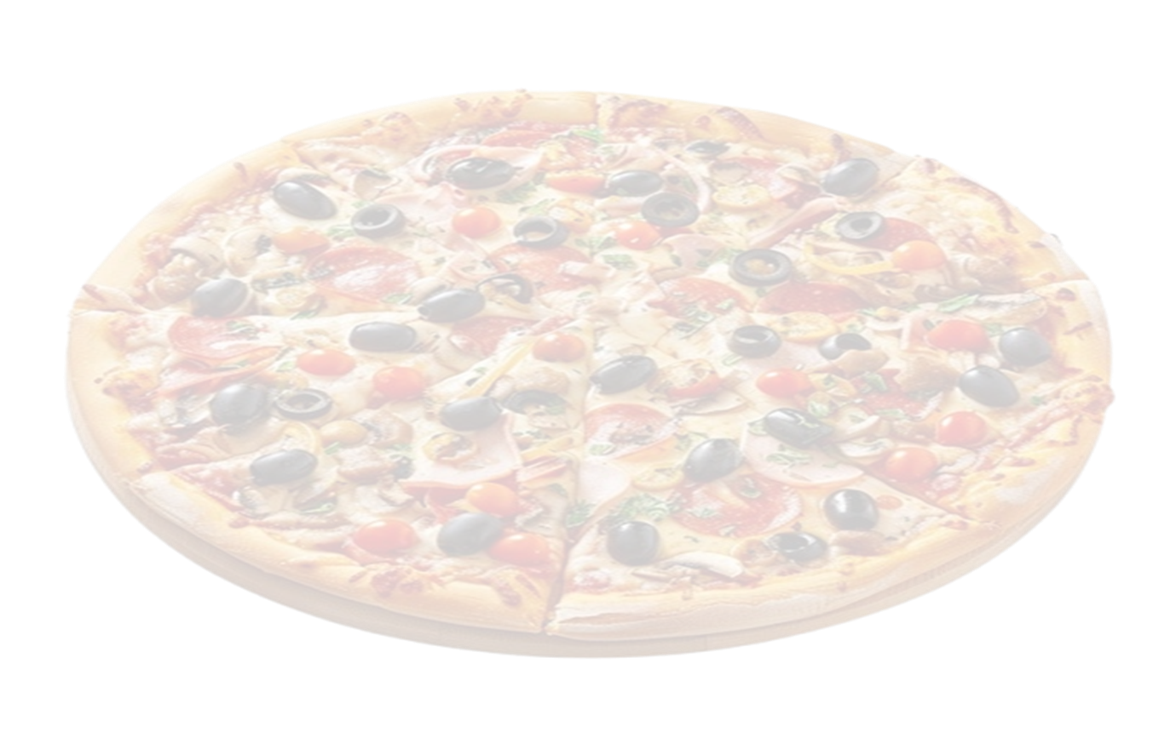
Pizza Sales Database Schema
This diagram represents the relationship between the key tables used in pizza sales dataset which includes : order, order_details , pizzas, pizzas_ types Csv datasets.
Understanding this schema enable accurate calculations and visualization in Power Bi.
Orders order_id order_date order_time
Order_details Order_details_id order_id Pizza_id quantity
Pizzas Pizza_id Pizza_type_id size price
Pizzas_types Pizza_type_id name category Ingredients

Slide 5
Sales Overview
TOTAL REVENUE $817.86k

Slide 6
Sales Overview
TOTAL REVENUE
$817,860
Seasonal Patterns
Summer Peak: July hits the highest sales at 72,500 for revenue, for Total Pizza Sold it 4,392 indicating summer is our strongest season.
Winter Dip: October shows a dramatic crash to just 64,000 & 3,883 for both sales - the lowest point of the year.
Recovery: November bounces back strongly to 70,400 & 4,266 for both sales- nearly matching summer levels.
Business Insights
Prepare for October: This massive 91% drop suggests seasonal factors (weather, holidays, or local events) significantly impact sales.
Summer Strategy: July's peak performance shows when to maximize our marketing and staffing.
Year-End Opportunity: The November recovery indicates strong potential for holiday season sales
Overall Trend: Sales remain relatively stable (65,000-72,500)& (4,392-3883) for most months except for the October anomaly; this suggest we have a healthy business with one significant seasonal challenge to address.
TOTAL PIZZA SOLD $50k

Slide 7
Daily Trends & Insight
Highest Demand: are on Friday(8,106 orders) is the busiest day, followed by Saturday(7,255). Weekly Trend: Orders rise steadily from Sunday (5,912) to Friday, then dip slightly on Saturday. Key Takeaway: Weekends (Fri-Sat) drive peak sales, but Friday is the clear standout. Recommendation: Boost staffing/promotions on Fridays to maximize revenue.

Slide 8
Hourly Trends & insight
Peak Performance: Pizza orders hit their highest volume at 12 PM (6,543 orders), indicating lunch is the busiest time.
Steady Decline: There's a consistent downward trend throughout the afternoon and evening, with orders dropping from 6,203 at 1 PM to 4,350 by 7 PM.
Action To be Taken Consider boosting or maximizing staffing or promotion during these hour to meet demands

Slide 9
Pizza Performance
Thai chicken pizza leads at $43,434.25(34%) Barbecue chicken pizza followed closely with $42,768(33%) California chicken pizza has $41,409.50(32%) these pizzas type are not only among the top five in orders but also generated the highest revenue.

Slide 10
Pizzas Performance

Slide 11
Pizza Performance
Big meat_s is the top ordered pizza, more ahead of others with other top contenders fairly close. • Thai ckn I generates the most revenue, despite not being the most ordered, which suggests an indication of higher price point. • The greek xxl is by far the lowest pizza based on revenue and orders. ACTIONS TO BE TAKEN • Big meat s sells the most but brings least revenue among the top 5 sellers, Pricing strategy should be reviewed for Big meat s as well as upselling to medium/large. • Thai ckn 1 is the MVP, it should be more prominent in menus and promotions, also run limited time offers with add-ons. • The Greek xxl is a losing product it should be rebranded or resize (xxl might be too big) • Survey Customers on Flavor Preferences. • Opt"ventory to focus on best sellers

Slide 12
Category Based Pizza Performance

Slide 13
Customer Insight
. Data from January - December 2015 shows that the Thai ckn generates 5.31% of the total revenue, our customers tends to order this most due to the unique and delicious combination of flavors and texture. • The Chicken category shows that 26.91% of our customer order pizza under this category mostly because of its loyal program (Buy Two & Get One For Free) and its popularity. • Based on recent reviews on our official websites this data shows that 30% of customer dropped bad review and comments on the Veggie category of pizza regarding the combination of ingredient used and the texture of the pizza.
• The Loyalty program on the Chicken category, offering a free pizza after two orders, drives 20% of sales repeat customers. This suggests a young, digital first customer base that values convenience and reward. IMPACTS: Marketing can target young individuals on social media (e.g., Instagram ads) and expand the loyalty program to boost repeat purchases

Slide 14
Challenges & Opportunities
Challenges: The brie_carre pizza accounts for only 1.42% of sales ($11,588.50), possibly due to its low demand because of its flavor and texture. Delivery delays on Friday as the busiest day during lunch hours 12-2PM (30% of orders) cause customer complaints.
Opportunities: Promote extra cheese (2,000 units sold) and soda (1,500 units) as upsells items , especially with the barbecue chicken pizzas (5.23% of revenue). Target dinner hours (6-8PM, currently only 10% of orders) with meal deals. Monetize the mobile app as we generate a lot of traffic than the official website.
Impact: Removing or rebranding the brie_carre pizza could free up menu space or rather do a thorough check through of its ingredients. Promotion on the barbecue chicken pizzas could boost sales by 20%, and faster delivery could improve ratings.

Slide 15
Q&A
How will the $5,000 social media campaign target college students?
Answer: Instagram ads for adult group, offering discounts to the college student.
Can we reduce delivery time without hiring more drivers?
Answer: Optimize routes or partner with a delivery app
Should we discontinue the Brie_carre pizza?
Answer: Test a rebranded versions before removing it

Slide 16
Recommendation
Invest $5,000 in a strategic campaign focused on promoting the Barbecue Chicken Pizza to college students. Utilize Instagram ads tailored for adult consumers to drive additional engagement and conversions.
Launch a new combo in the Supreme category featuring the Classic Deluxe Pizza, extra cheese, and a soda—positioned to rival the Thai Chicken Pizza and enhance upsell opportunities related to the Barbecue Chicken offering.
Expand delivery staff for Fridays between 6–8 PM, which account for 30% of daily orders. The goal: reduce average delivery time from 35 minutes to 25 minutes—competitive with Domino’s delivery standard.
Elevate Brand Visibility by incorporating a signature pizza icon or logo in promotional materials and packaging to enhance recognition and trust.

Slide 17
Conclusion
This project showcases how raw sales data can be turned into actionable business insights—from identifying customer preferences and top-selling pizzas to pinpointing peak order times and key revenue drivers. By leveraging a data-driven approach, we empower smarter decision-making, support stakeholders in increasing sales, enhance customer satisfaction, and streamline operational efficiency.

Slide 18
Thank You

